Slide 1
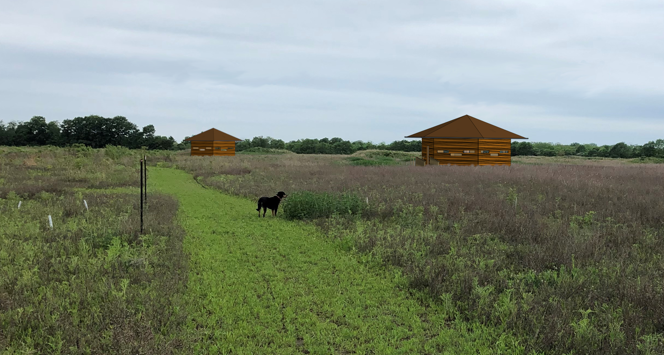
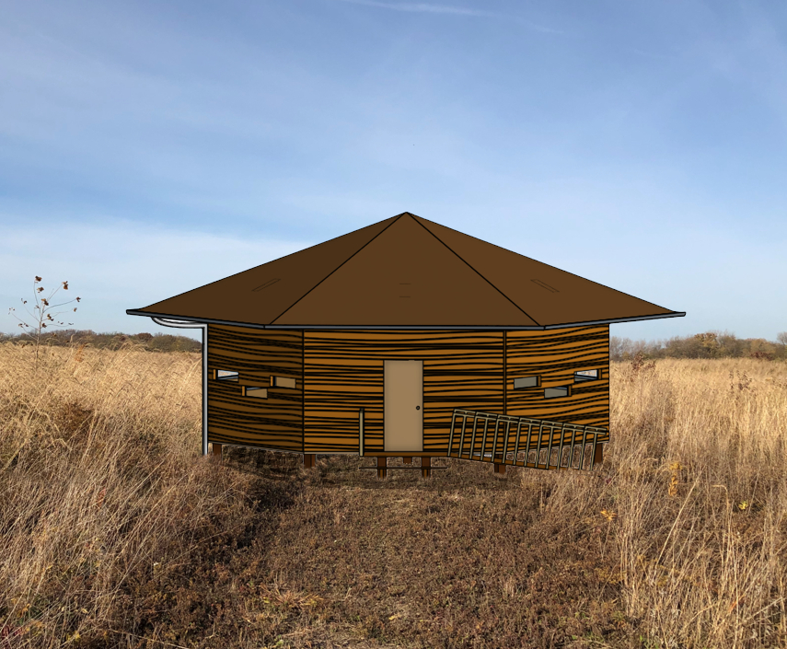
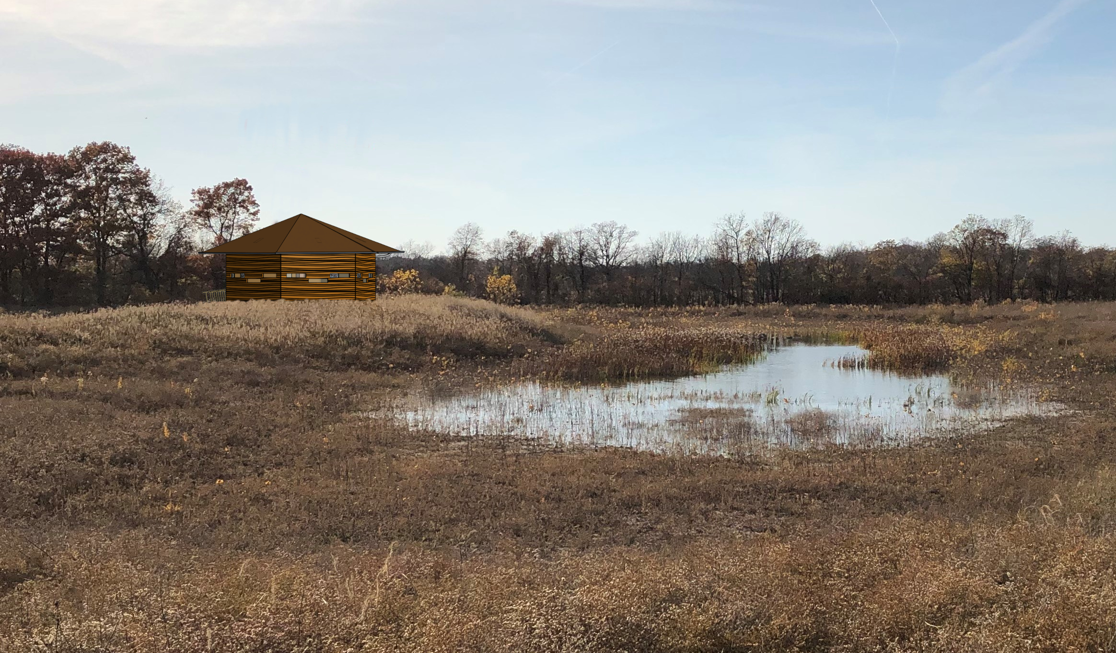
The Pelee Hut
Notes:
*****Start with a Layperson’s Summary: Very concisely introduce the problem in a non-technical fashion. Do not redeliver your Need Statement. Do not state all your insights or detail all aspects of desired outcomes, but instead focus on the essence (i.e. main goal and obstacles) of your project. Do this in a way that gets your listener’s attention and makes sense to people unfamiliar to the project
.•Covering the “For... (Target audience)” “Who are dissatisfied with ... (the situation)”
Provide a high-level overview of the solution created by the team including major technical/engineering/creative/innovative features, overall practicality and/or benefits of the solution.
•Covering “Our solution is a ... (description)” “That provides ... (compelling value)” “Unlike ... (alternative)” “We have assembled ... (key features)”3.Brief synopsis of why your solution is preferrable to the alternatives, either through comparisons or other evidence. *********
Problem: This project is for The Nature Conservancy of Canada, who would like an accessible hide for visitors to view the wildlife of Pelee Island.
Competitors/ What we do different: Most hides disrupt wildlife by taking over animal's habitats, but our hide is integrated into the environment in a way that provides a space for people to enjoy nature while encouraging wildlife to interact with the hide.
Solution: Our solution is to create a hide that will provide visitors a near 360-degree view of the area; unlike some hides that are more boxy in shape, ours provides access to many viewing angles at windows of various heights to allow for better accessibility. Furthermore, our design has left space beneath for small ground animals and a gap in between the roof and ceiling with artificial nesting sites for birds. This is to ensure both that local wildlife is as undisturbed as possible, and that visitors to Pelee Island are able to see more wildlife. With comfortable seating and viewing, garbage disposal, and coat hooks, the hide will greatly improve visitors' experience at Pelee Island.

